Slide 1
Spiderman’s best Villian
GianCarlo Rappa

Slide 2
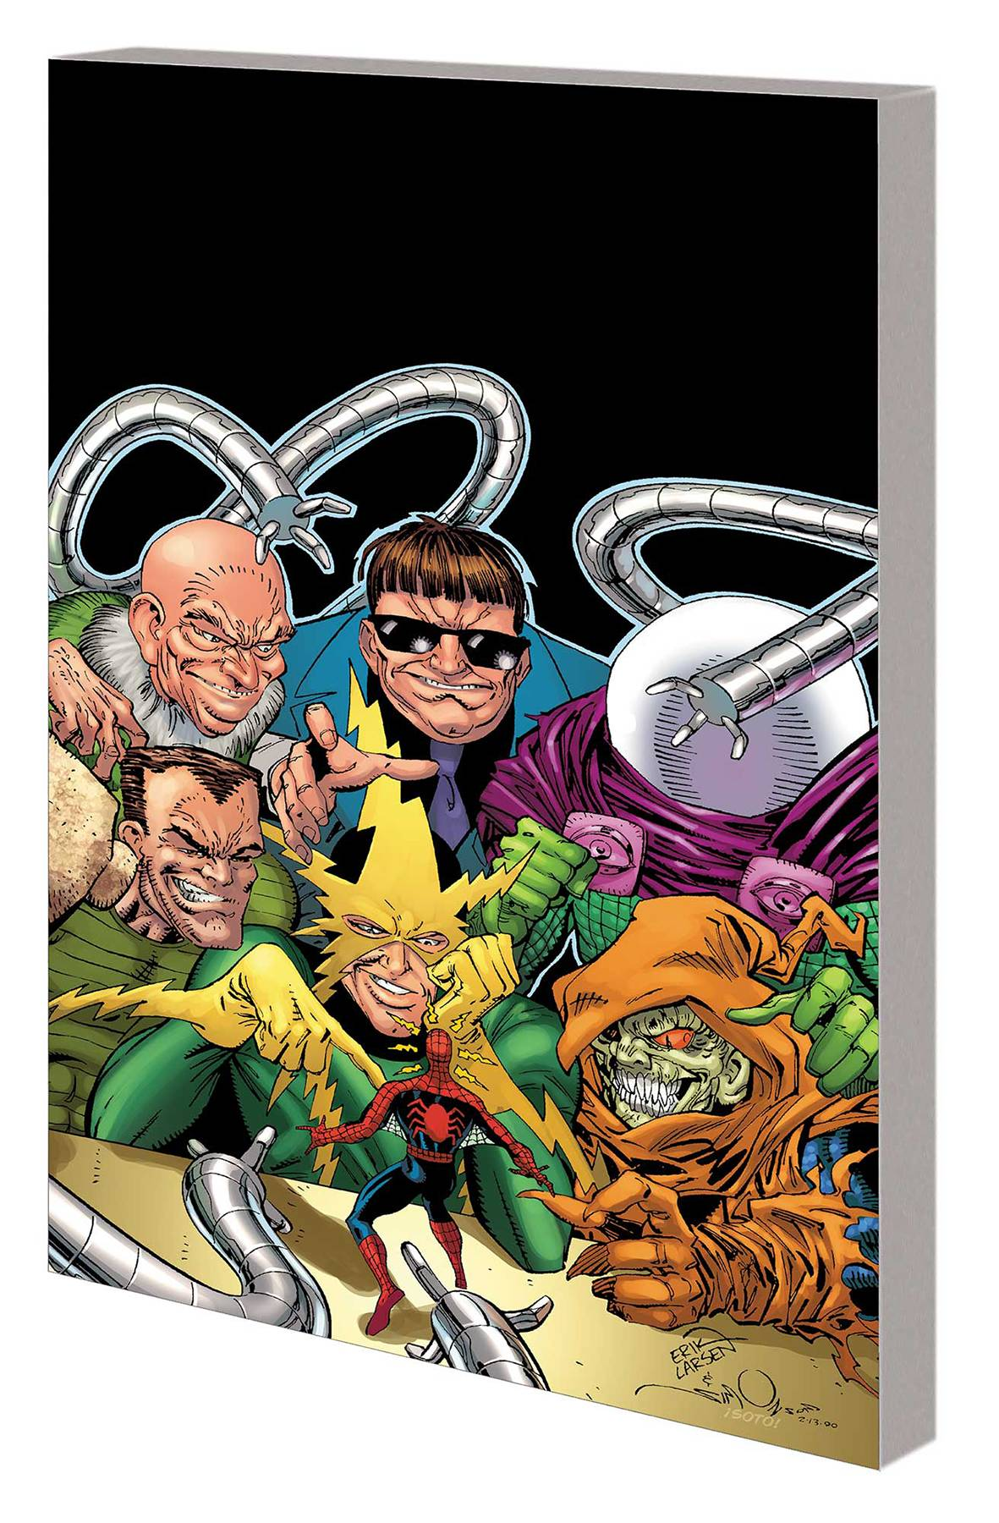
Rogues Gallery
Spiderman’s rouge gallery consist of greats such as
-Green Goblin
-Doctor Octopus
-Venom
-Stilt-Man
-Kingpin

Slide 3
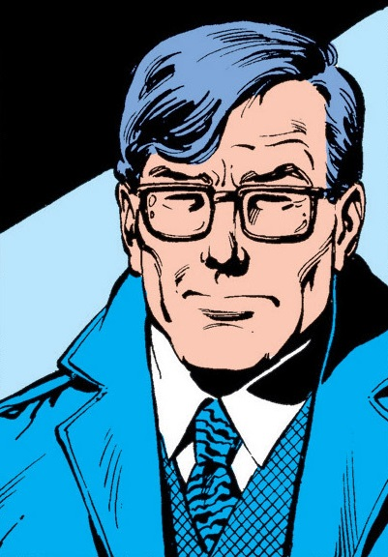
Jackson Weele
-Husband
-Corrupt businessman
-5′5″ (1.65 m)
-Weight 140 lbs (63.5 kg)
-Eyes: Brown
-Hair: Grey hair
-College educated

Slide 4
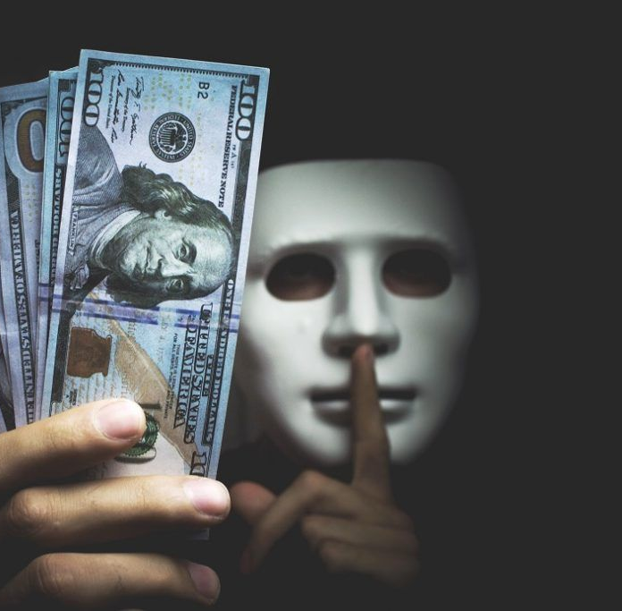
origin
-Jackson Weele embezzled money from his own company
-Kept the records of his embezzlement
-Evidence could put him in jail for 15+ years and wife will leave him
-Hires the Rocket Racer to steal records backs
-Rocket Racer did so, used the evidence to blackmail Weele.
Amazing Spider-Man Vol 1 182

Slide 5
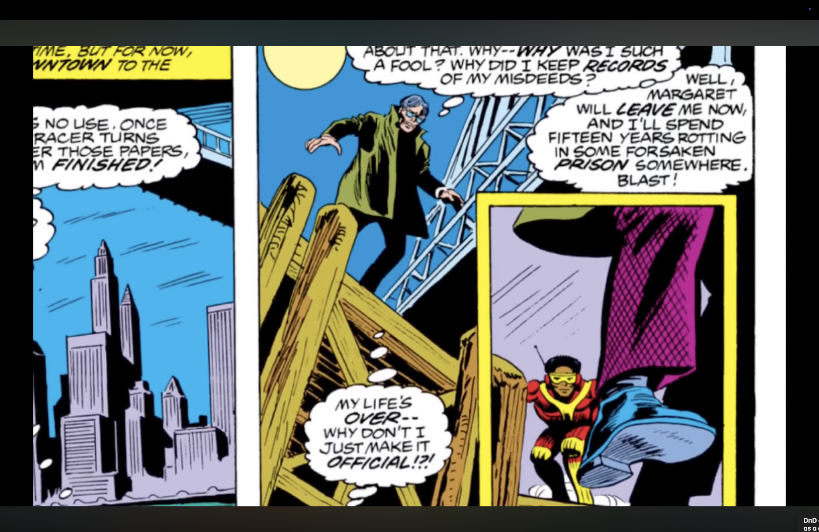
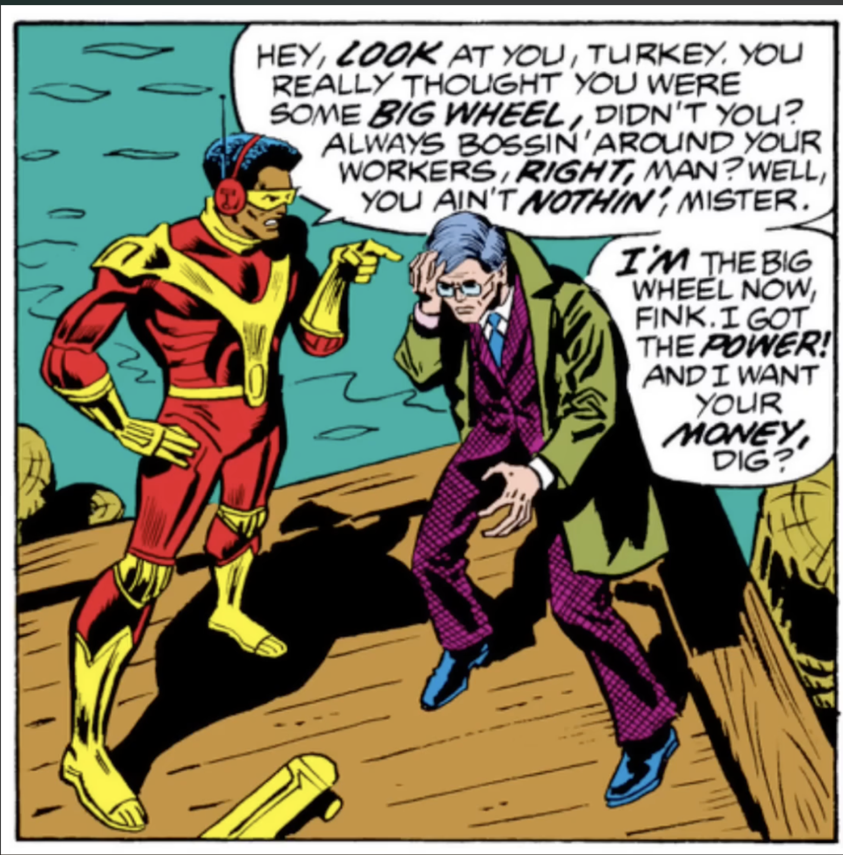

Slide 7
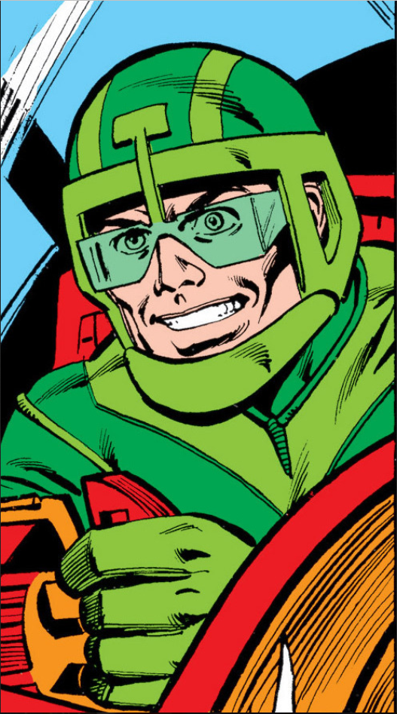

Slide 8
Big Wheel
-Evil Villain
-Corrupt human
-Wants to destroy Rocket Racer
-5′5″ (1.65 m)
-College educated
-Pilots The Big Wheel

Slide 9
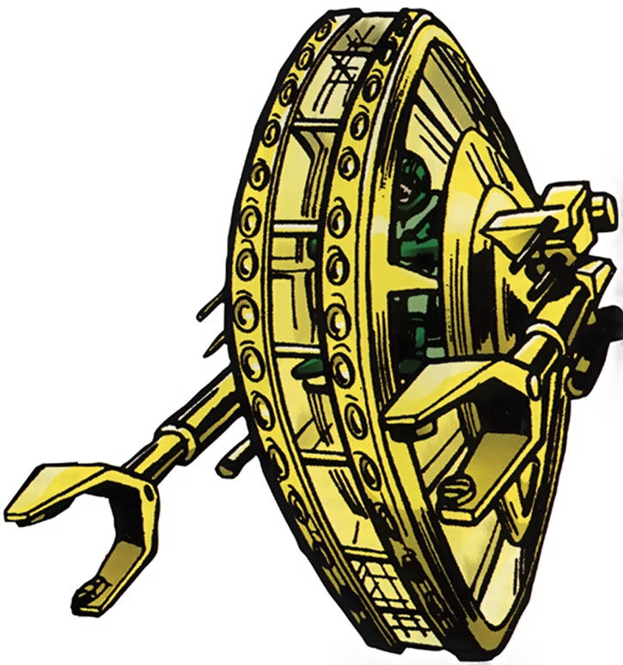
The Big Wheel
-Big monowheel
-Air tight
-large mechanical wheel

Slide 10
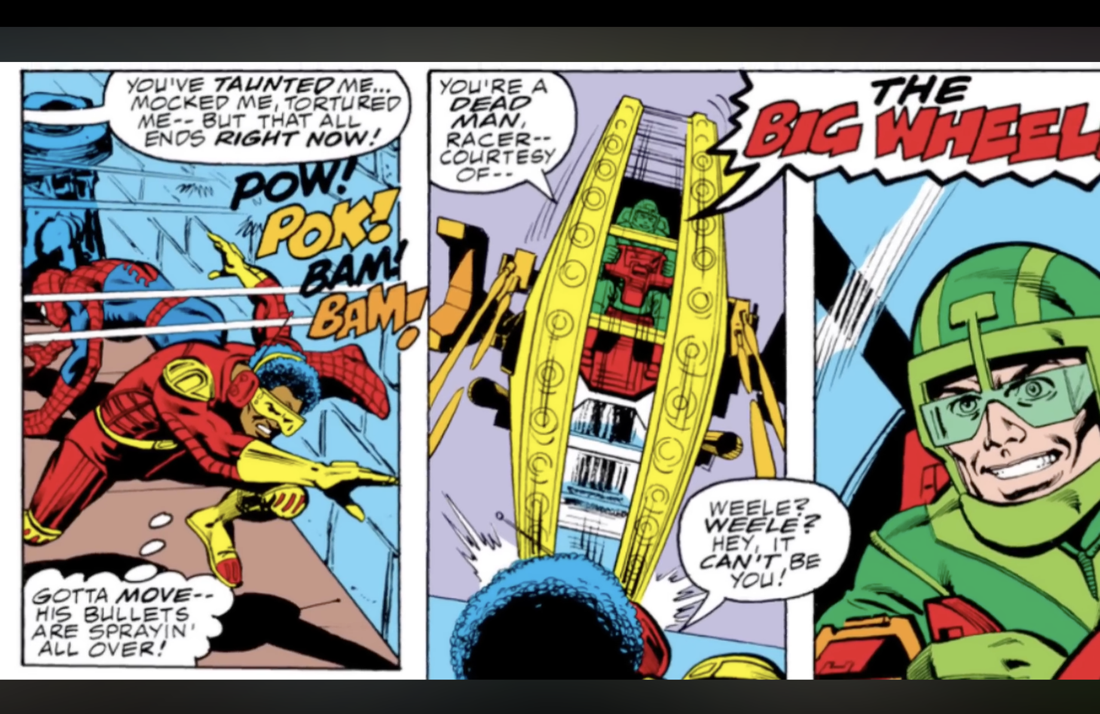

Slide 11
The Big Wheel
-Big monowheel
-large mechanical wheel
-Air tight
-Has machines guns

Slide 12
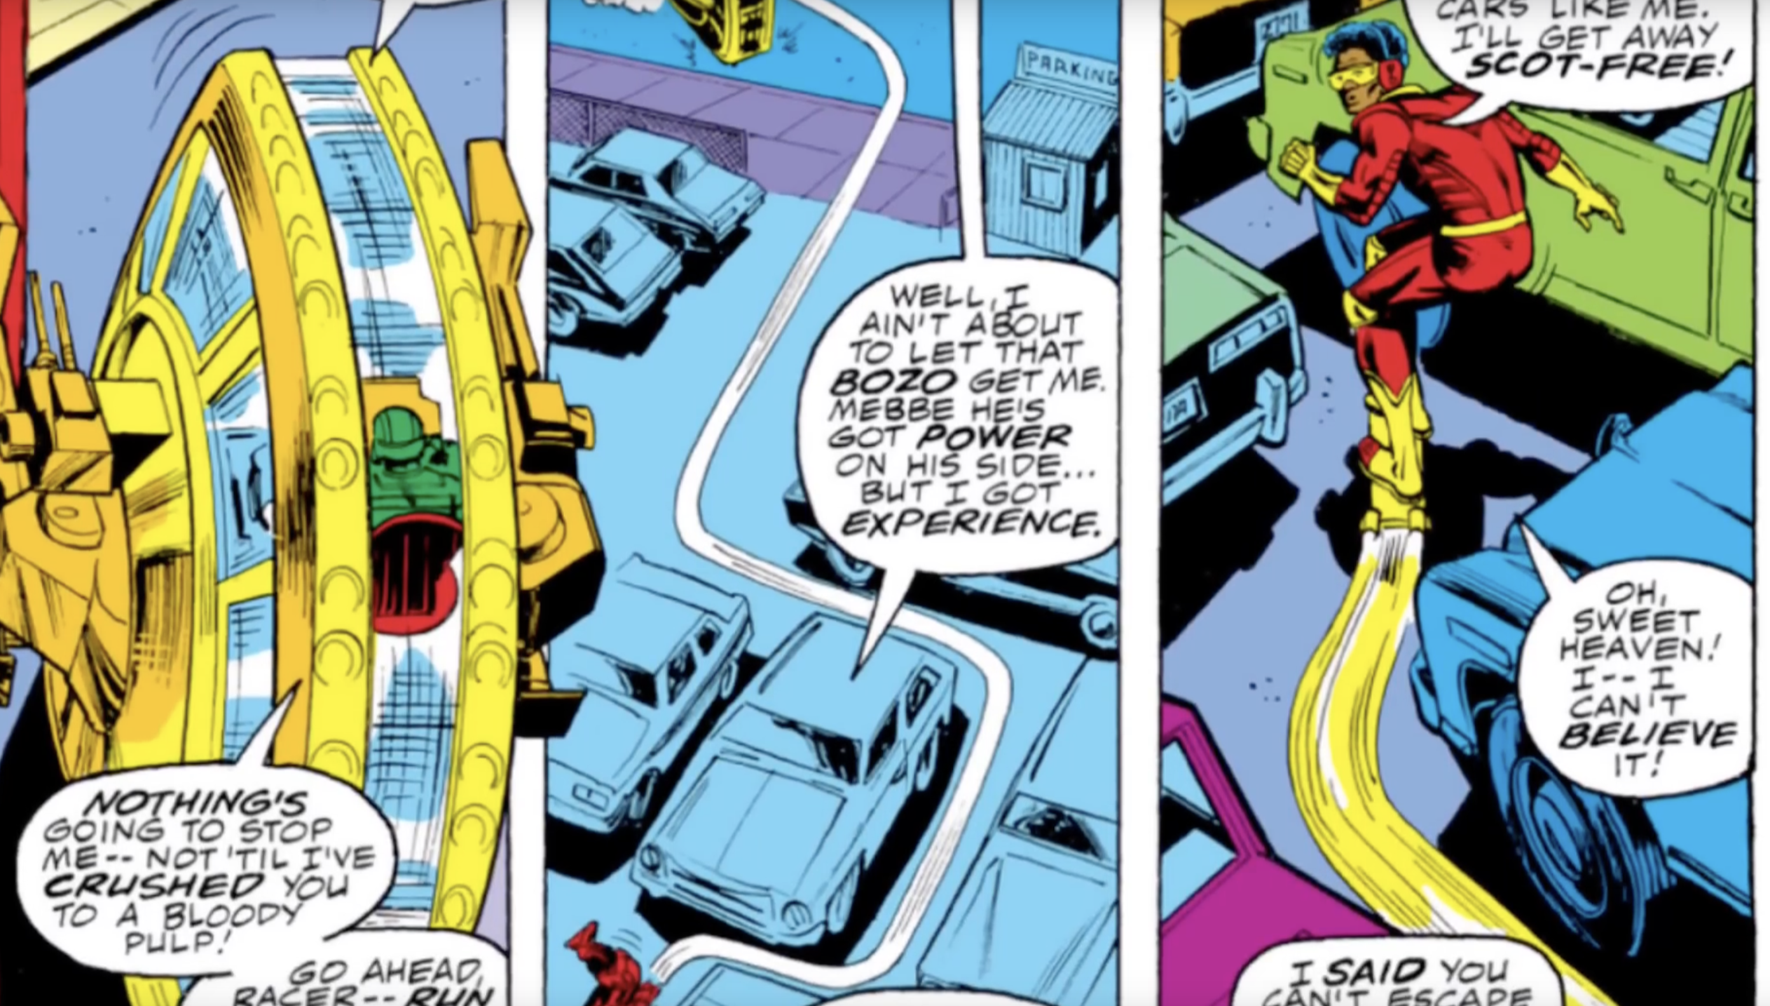

Slide 13
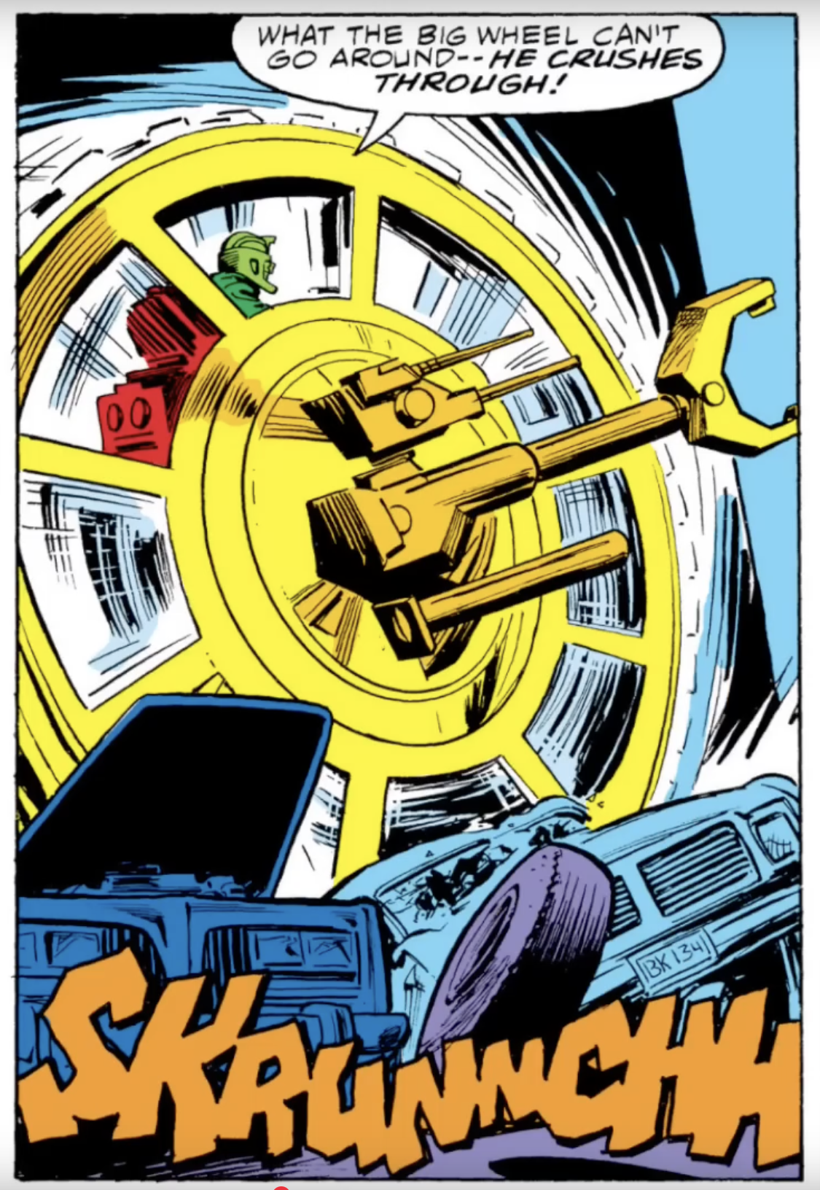

Slide 14
The Big Wheel
-Big monowheel
-large mechanical wheel
-Air tight
-Has machines guns
-Can crush cars with ease

Slide 15
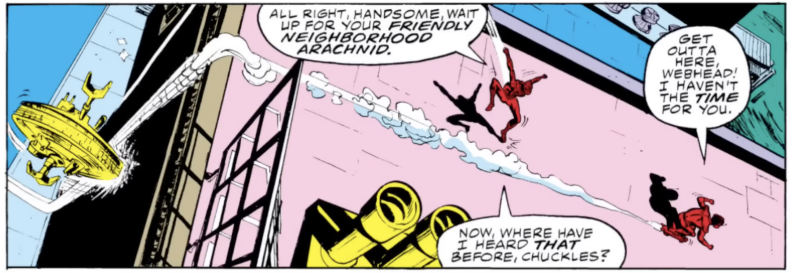

Slide 16
The Big Wheel
-Big monowheel
-large mechanical wheel
-Air tight
-Has machines guns
-Can crush cars with ease
-Can ride up walls

Slide 17
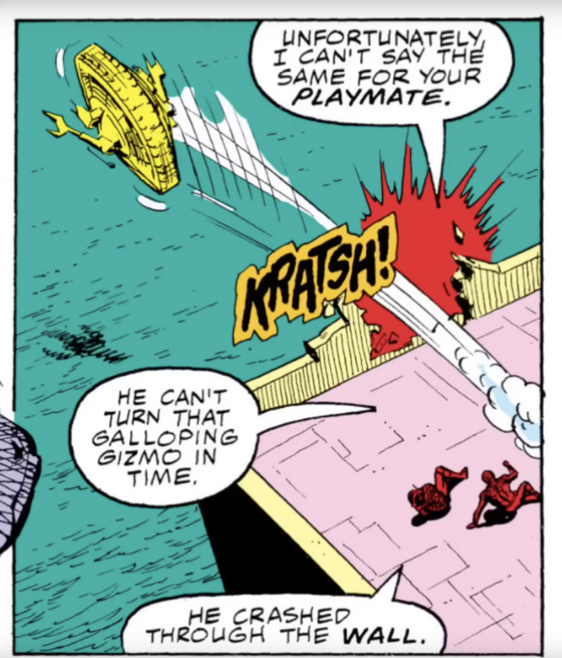

Slide 18
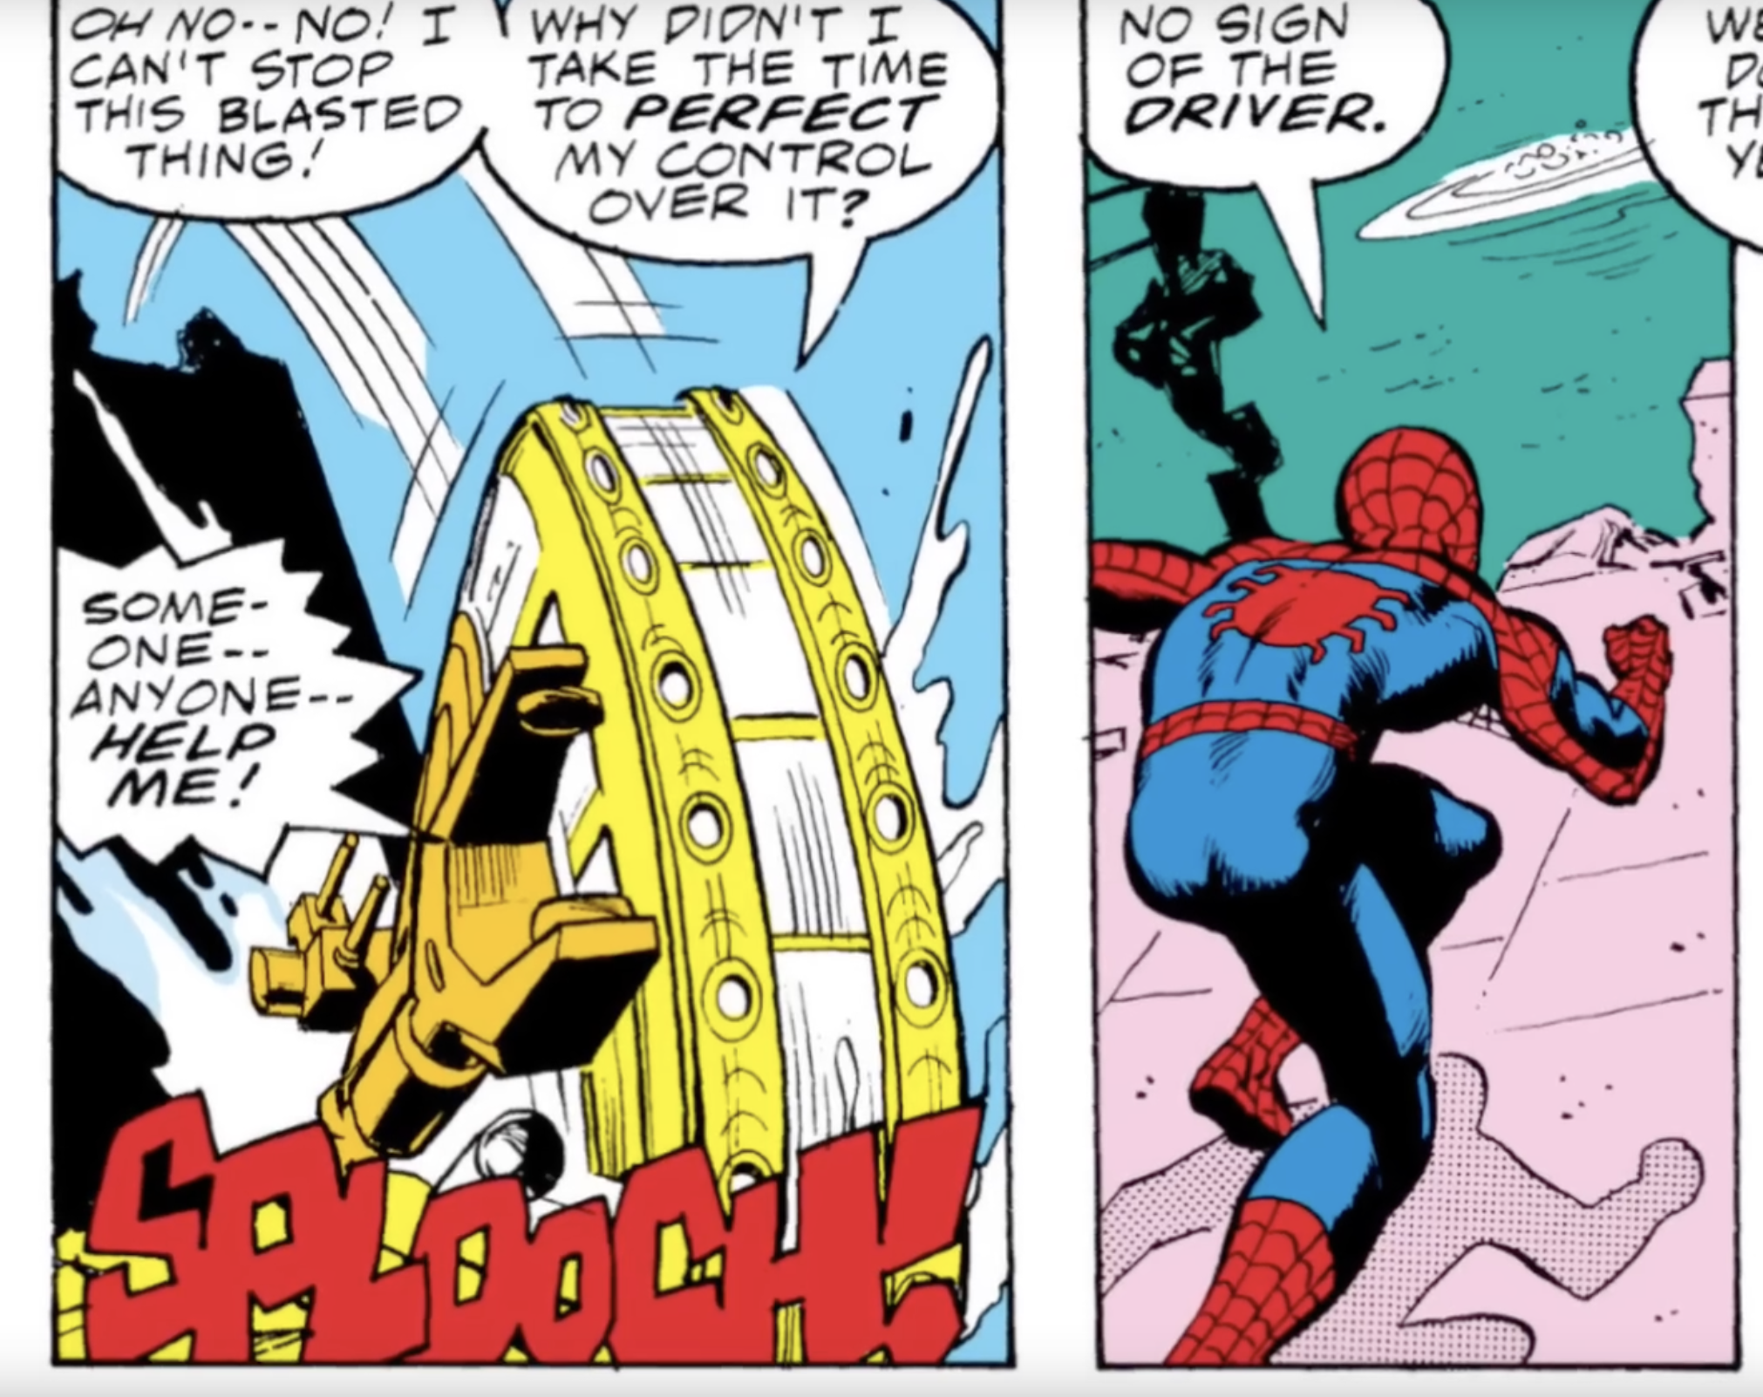

Slide 19
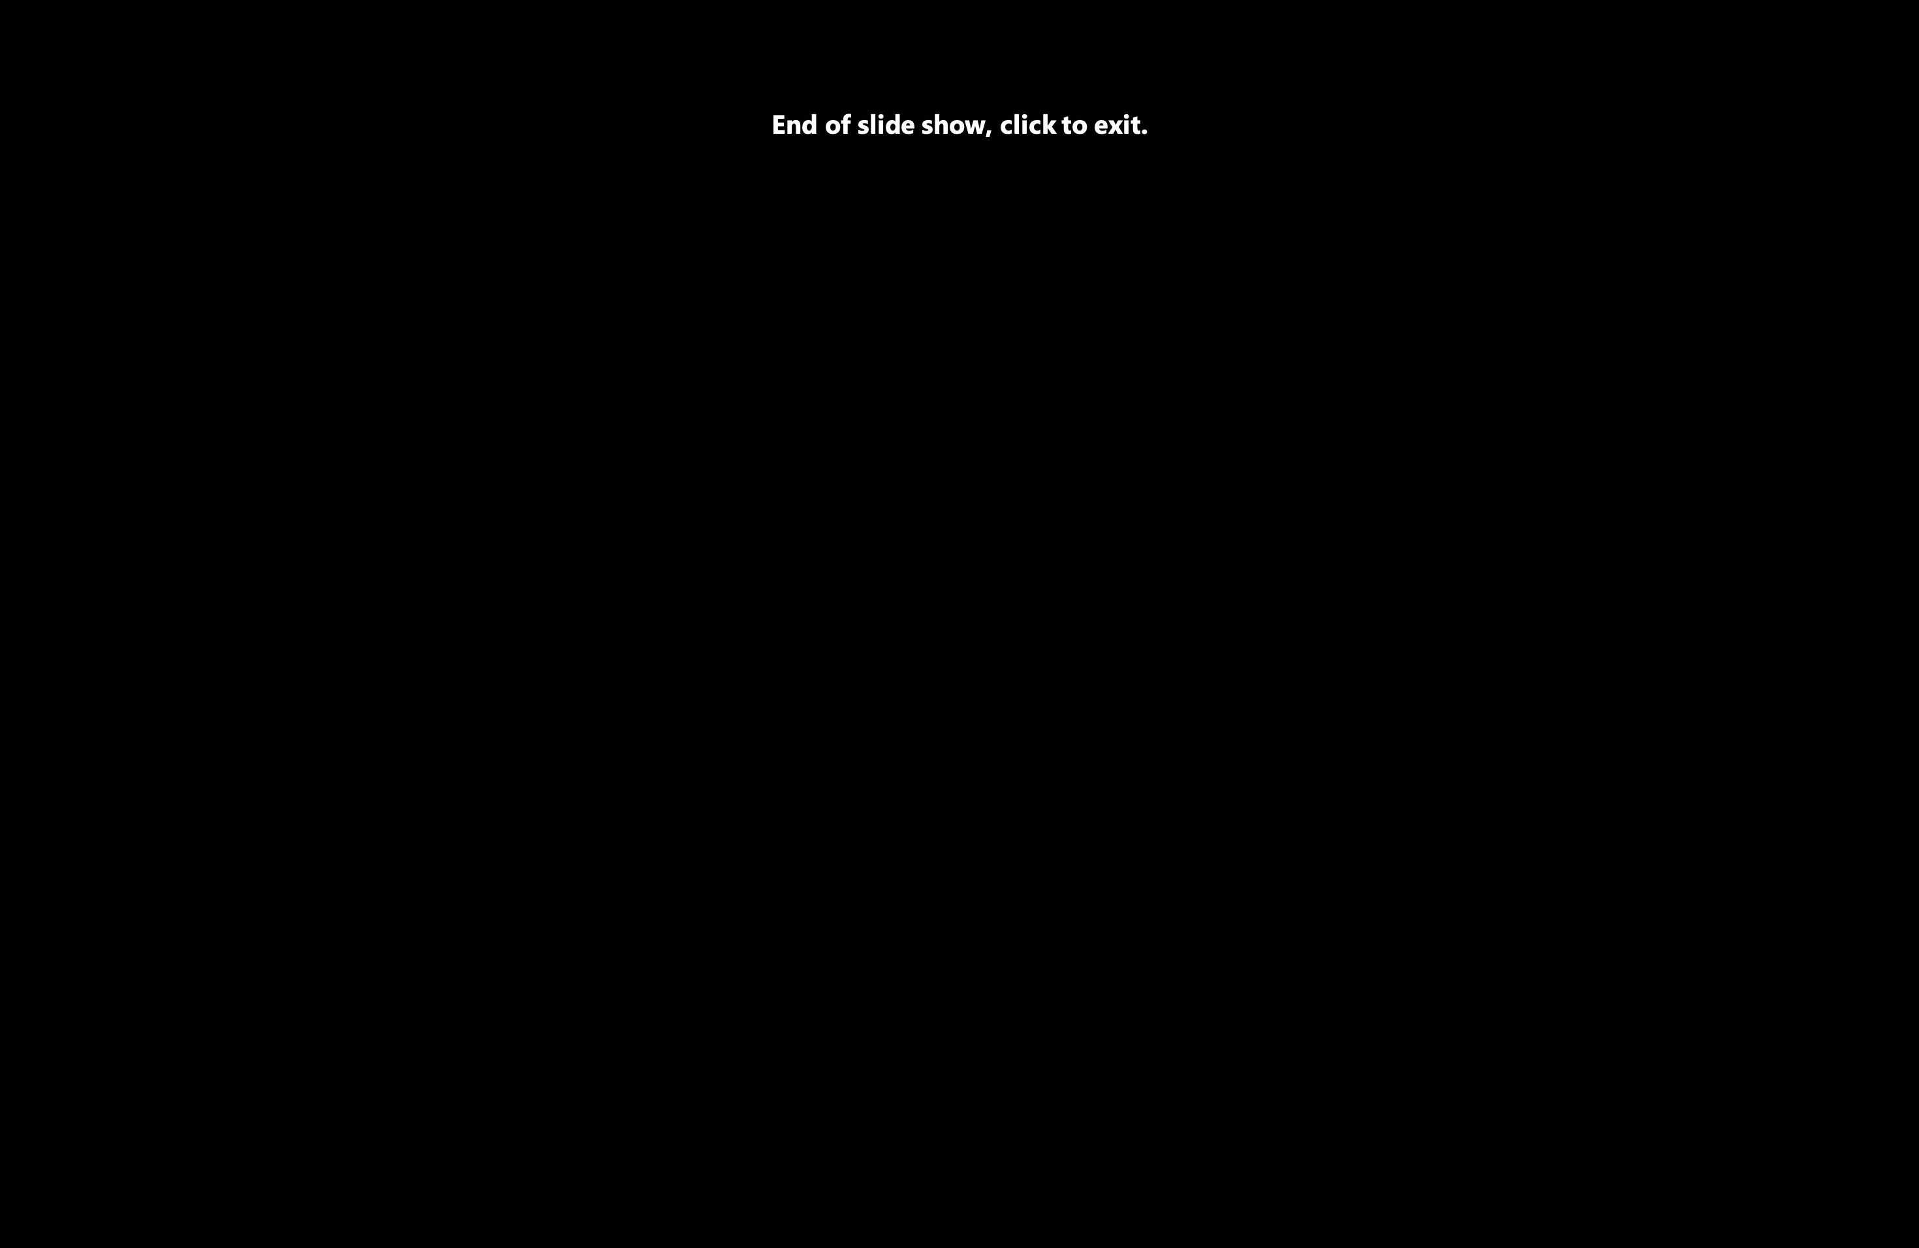


Slide 20
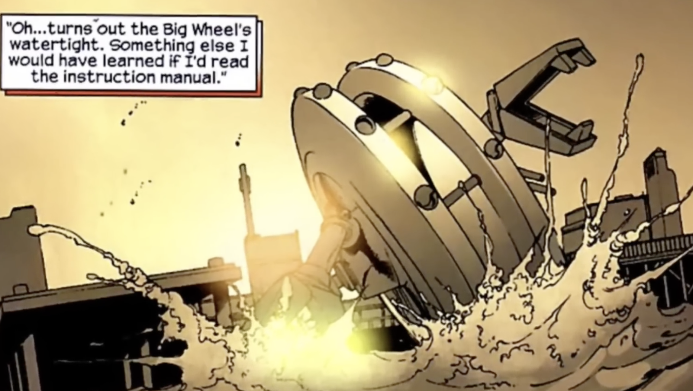

Slide 21
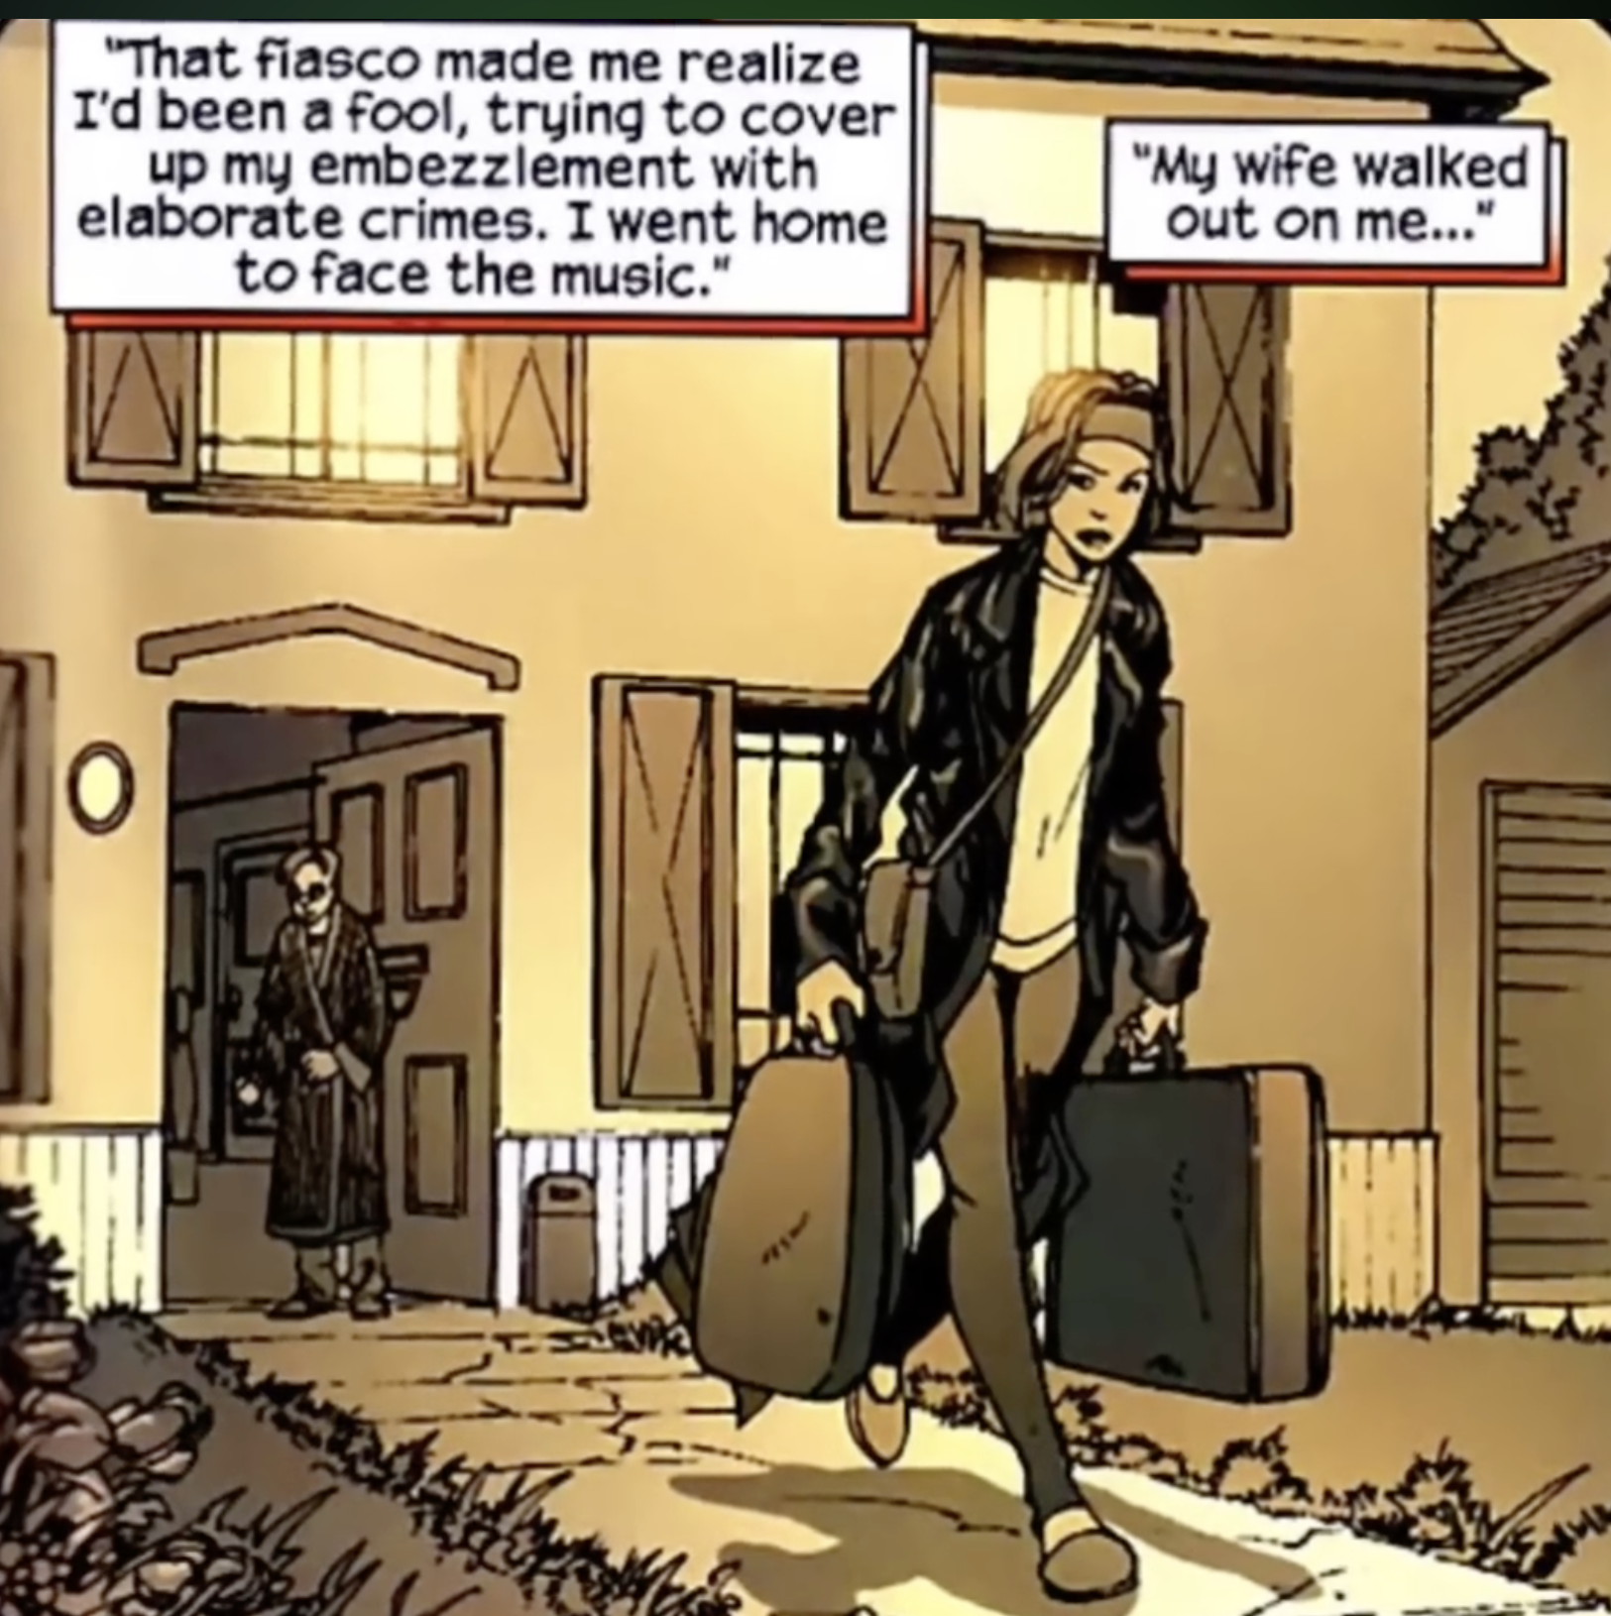

Slide 22
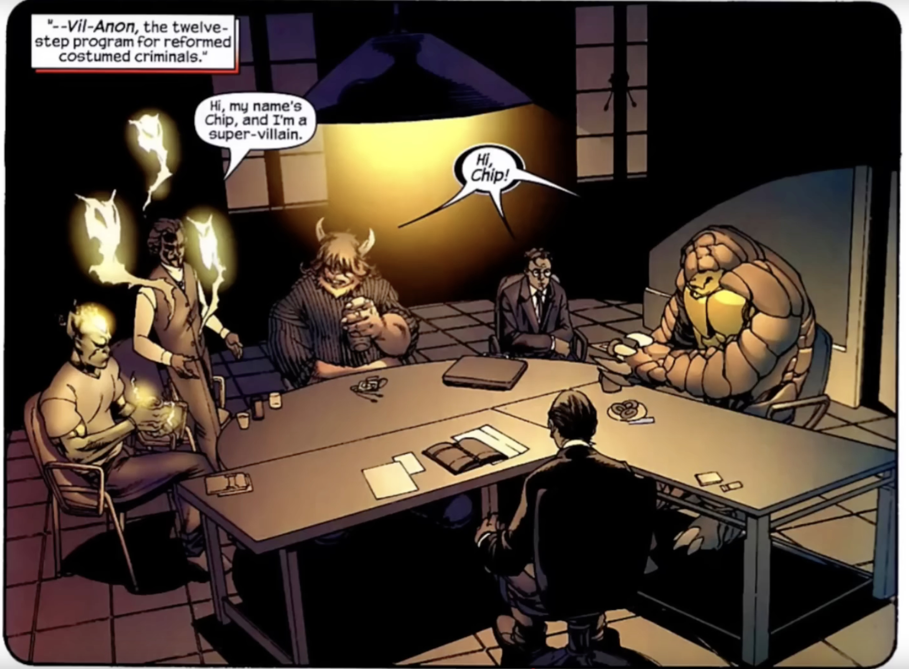

Slide 23
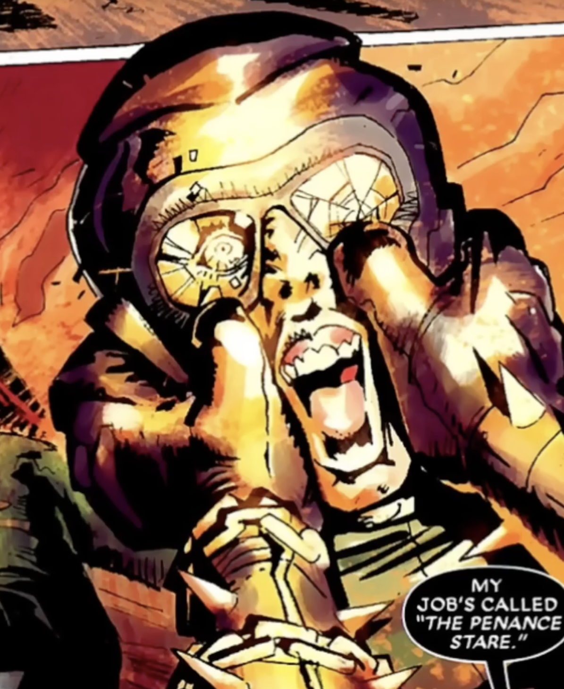
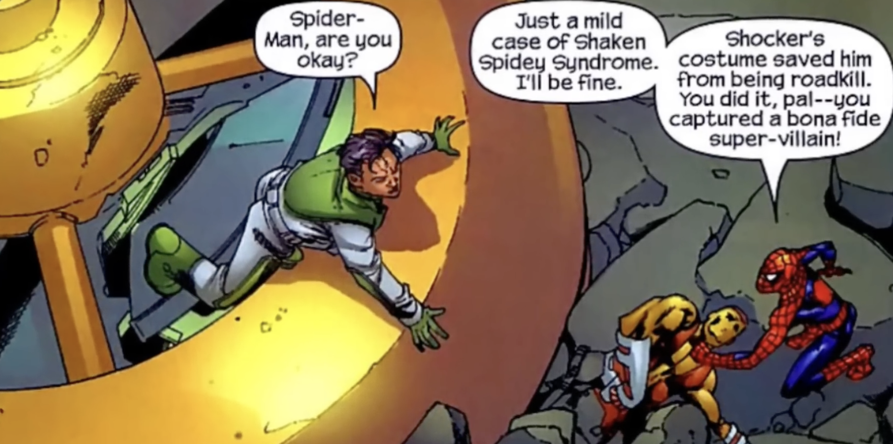
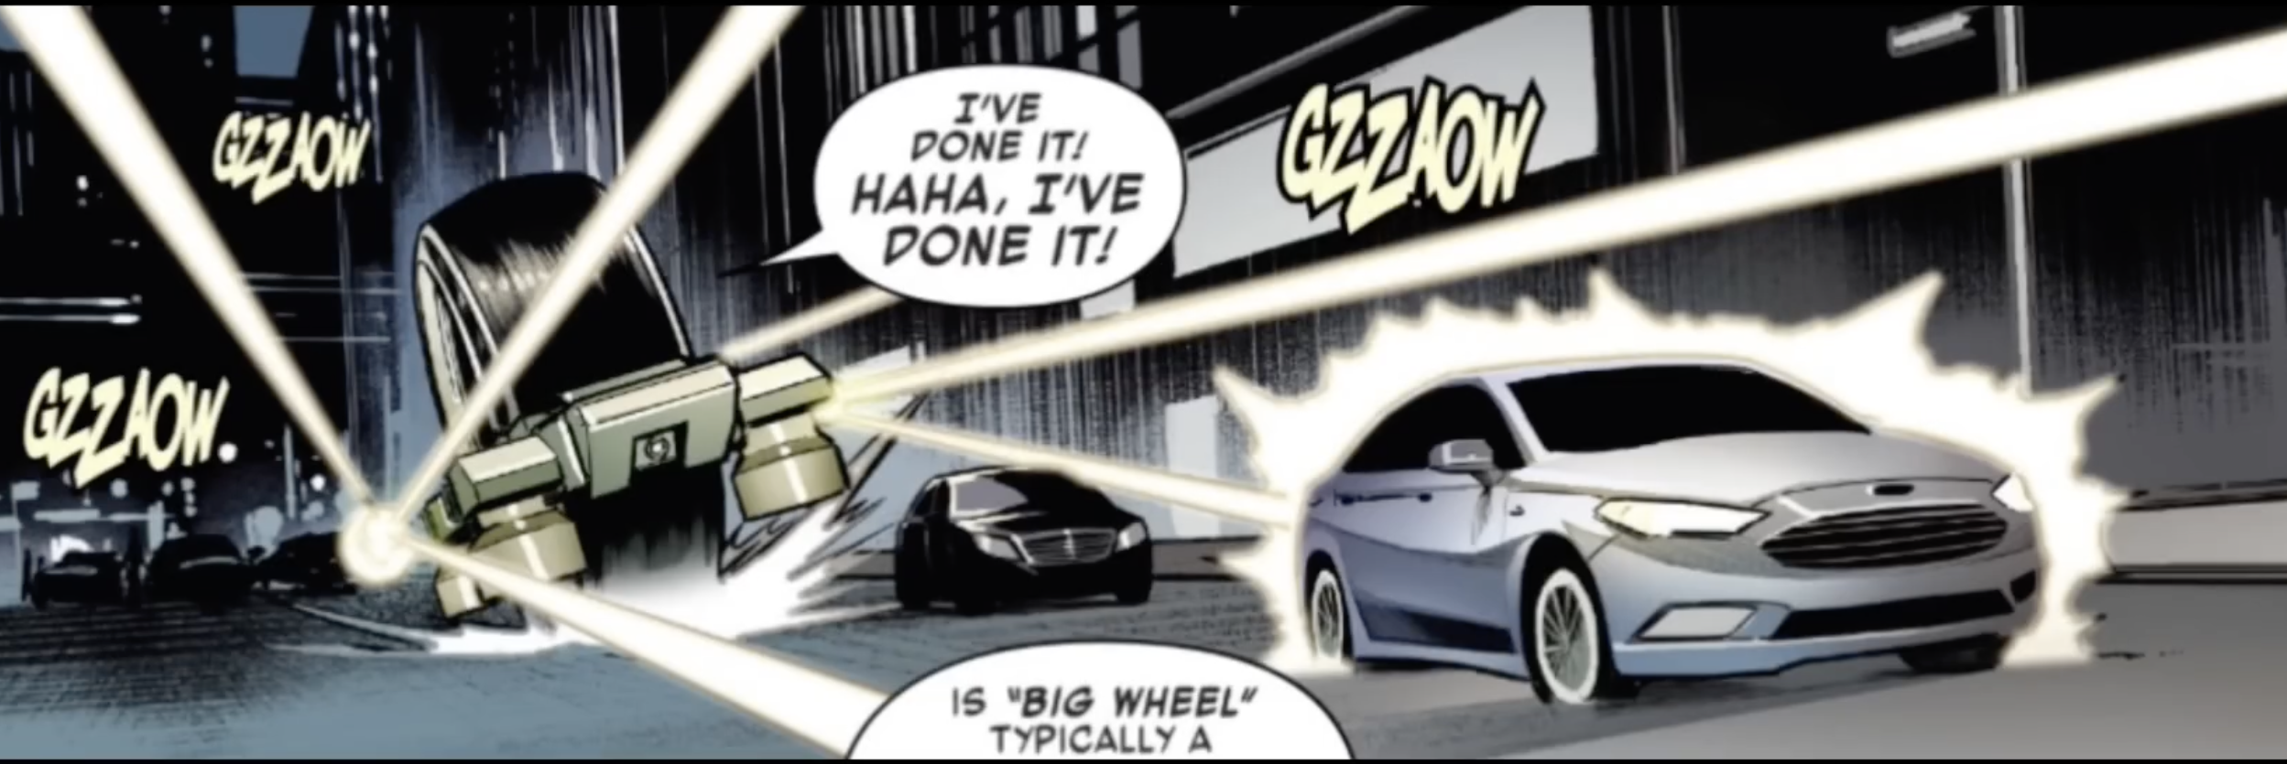
Other Big Wheel adventures

Slide 24
The Big Wheel
-Big monowheel
-large mechanical wheel
-Air tight
-Has machines guns
-Can crush cars with ease
-Can ride up walls
-CAN GET RID OF TRAFFIC

Slide 25
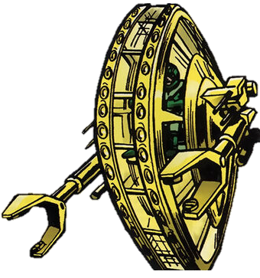
THANK YOU

